Slide 1
Welcome to Christopherson

Slide 2
MSU Travel – Christopherson Business Travel
What is changing:
Michigan State University is partnering with Christopherson Business Travel to manage travel.
Christopherson will be servicing faculty, staff, student, group and guests traveling on approved MSU travel.
As of January 8th, new reservations to be booked with Christopherson. Contact information provided on a separate slide.
What is not changing:
There will be no impact to the MSU Travel Card, MSU Event Card, MSU airline ticket payments, or Concur.
MSU’s travel policy: https://ctlr.msu.edu/COMBP/mbp70EBS.aspx#I
Travel@State: https://ctlr.msu.edu/COTravelNew/default.aspx
msutravel@cbtravel.com | 800-509-7081

Slide 3
Why Christopherson?
We Value People. We Create Value.
Big agency ability. Small firm personality.
University Experience – Christopherson has 30+ years of experience navigating the need of traveling for higher education.
Service Solution – A best-in-class travel management company with proven track record in delivering innovative, local services and solutions.
Premium service offering – Designated consultant team to MSU. Agents and support teams who will learn MSU’s traveler preferences and needs.
Flexible travel partner – Nimble and agnostic approach. Christopherson focuses on feedback and suggestions to increase traveler satisfaction.
msutravel@cbtravel.com | 800-509-7081

Slide 4
MSU Designated Full-Service Advisor Team​
Advisor Name​ | Experience ​
Kari Fichter​ | 23 years in the industry​ 3 years with Christopherson​ Kari prides herself on customer experience​ Vast experience in all aspects of higher education ​
Allison Holms​ | 25 years in the industry​ 2 years with Christopherson​ Allison enjoys navigating the unique needs of higher education​ She also loves explaining the intricacies of airline policies and fare rules with her travelers ​
Pooja Malik​ | 22 years in the industry​ 2 years with Christopherson​ Pooja has a special place in her heart for international travel and loves to help others in booking their global trips​
Latasha (Tasha) Jackson​ | 10 years in the industry​ New to Christopherson​ Tasha also loves to travel and is excited to provide exceptional service to her higher education travelers​
All advisors are experienced in Fly America regulations
msutravel@cbtravel.com | 800-509-7081

Slide 5
Important Contacts | https://ctlr.msu.edu/COTravelNew/Contacts.aspx
Contact Type | Types of Services | Contact Information ​
Individual Advisor Bookings | Complex international bookings Emergency afterhours assistance Multi-city reservations Trips that combine personal & business | msutravel@cbtravel.com 800-509-7081 toll free 801-695-9278 for service when outside the US *Advisors also assist with groups for afterhours emergencies
Business hours: M-F 8 AM-8 PM ET Emergency afterhours: 8 PM-8 AM ET *Emails are not monitored afterhours
Concur Travel Reservation Support | Navigational support for Concur Travel Questions on errors/issues with Concur Travel Simple international reservations | onlinesupport@cbtravel.com 888-535-0179
Business hours: M-F 9 AM-8 PM ET
Group Travel for 10+ Travelers | Group air reservations Hotel room blocks Budget quotes for group travel Charter transportation | msugrouptravel@cbtravel.com 866-371-3580
Business hours: M-F 8 AM-8 PM ET
MSU Concur Help | Profile Settings Electronic Receipts Request Expense Concur Mobile and TripIt | concurhelp@msu.edu
MSU Travel Policy and Reimbursement | Questions on travel policy Information about Reimbursement | concurhelp@msu.edu 517-355-5000
msutravel@cbtravel.com | 800-509-7081

Slide 6
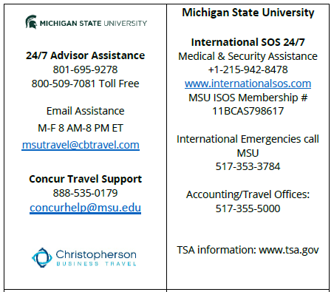
MSU Contact Reference Card
Located in the Travel Listserv
msutravel@cbtravel.com | 800-509-7081

Slide 7
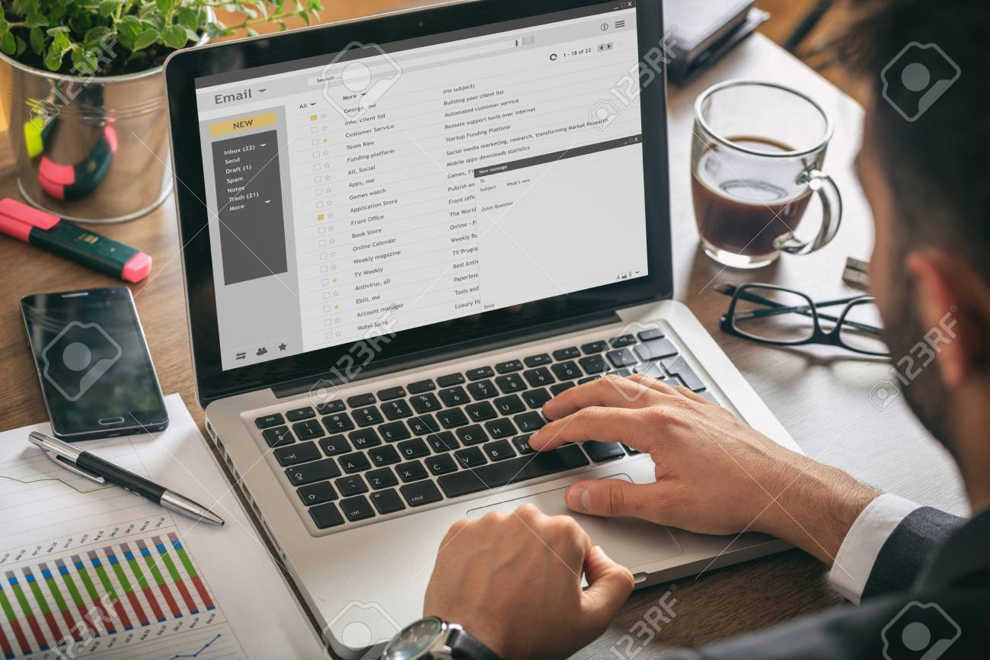
Quote Process from a Full-Service Advisor
Email/Phone travel requests. *Use phone for more urgent needs
Christopherson will share options via email
MSU traveler or arranger validate flights, seats, etc.
Airline fare rules determine last date to ticket
Fares are subject to change
Once itinerary is reviewed contact Christopherson to book
Itinerary document
Christopherson tentative itinerary sent to traveler (and/or their arranger if applicable).
Review detail for accuracy
Full details of air/hotel/car booking
Fare quote for selected itinerary
Trip Invoice
Christopherson issues ticket(s) and sends traveler (and arranger if applicable) final itinerary which acts as the invoice also
Questions or changes contact assigned the Christopherson agent team – provide booking reference if possible
msutravel@cbtravel.com | 800-509-7081

Slide 8
Response Times
Use phone for more urgent needs
Category | Typical Response Time
Telephone Business Hours 8am – 8pm ET Mon - Fri​ | Most calls will be answered within 20 seconds
Telephone After-Hours 8pm – 8am ET Mon – Fri Sat/Sun & Holidays | Most calls will be answered within 90 seconds
Emails Business Hours 8am – 8pm ET Mon - Fri | Most emails will be acknowledged within 30 minutes Most emails will be responded with action within 4 hours
Expect longer response times when there is extreme weather or other aircraft disruptions
If your email exchanges exceed 5 or more, consider a phone call with that advisor for clarification
If you do not receive your itinerary in the same business day, please reach out for status
msutravel@cbtravel.com | 800-509-7081

Slide 9
Sample Itinerary Email
msutravel@cbtravel.com | 800-509-7081

Slide 10
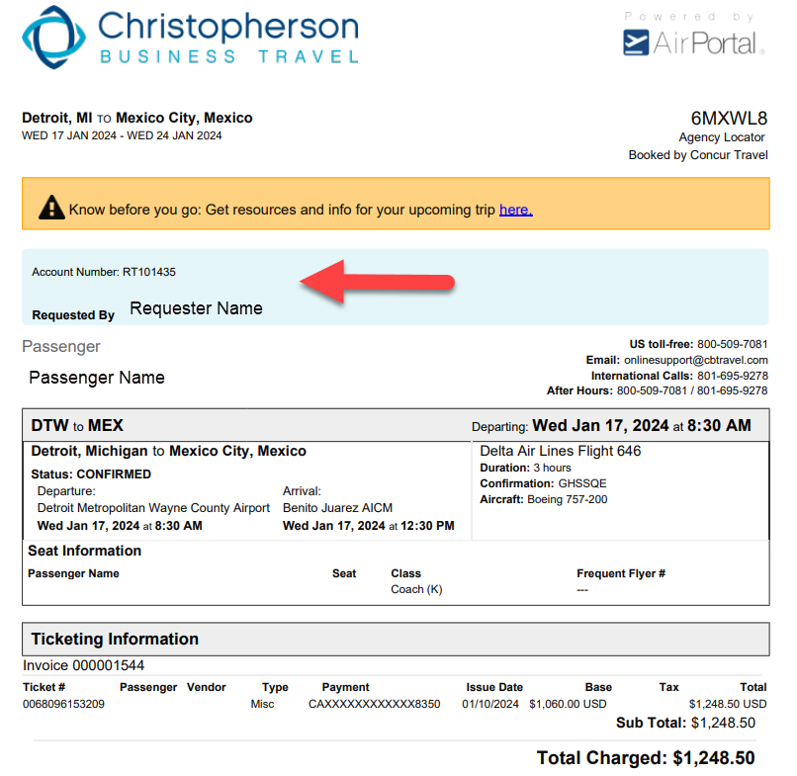
Sample Itinerary
Calendar & TripIt integration
This is your invoice also
The total charges are noted at the bottom of the itinerary
msutravel@cbtravel.com | 800-509-7081

Slide 11
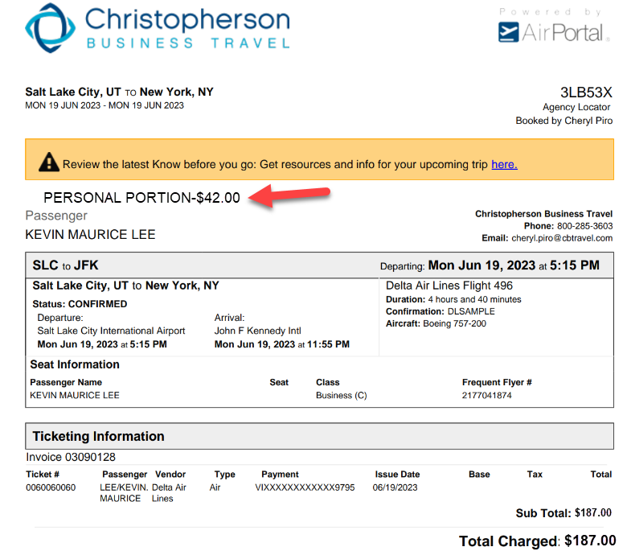
Personal Travel
*New Benefit Through Advisors*
If the trip includes a personal portion inform the advisor
The advisor will notate the personal amount in the remarks on your itinerary
You can continue to use the current process within Concur if preferred
msutravel@cbtravel.com | 800-509-7081

Slide 12
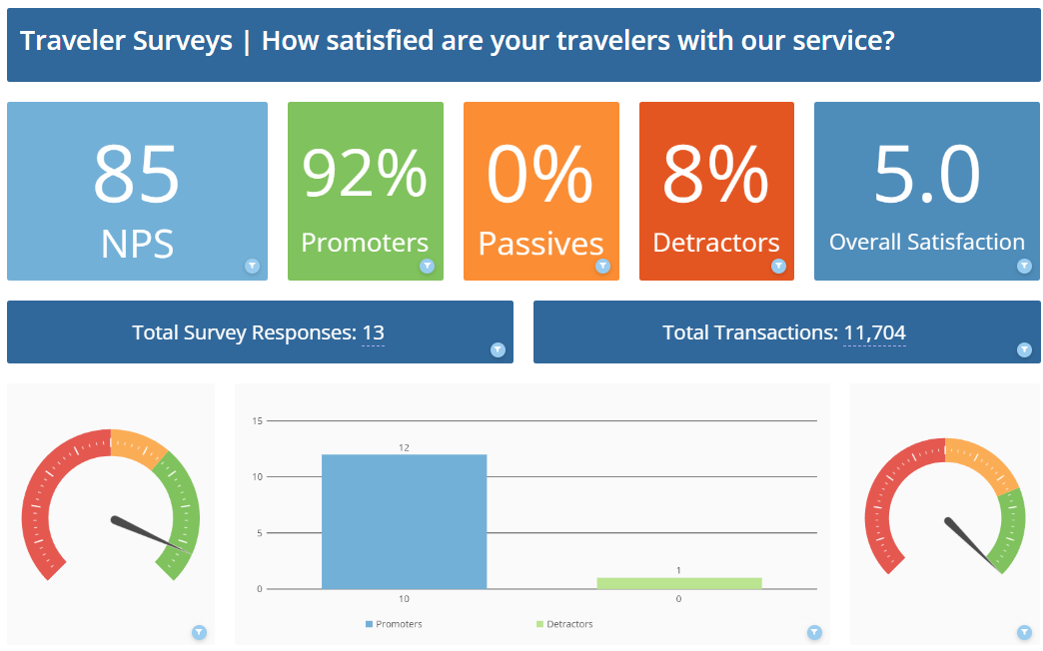
Feedback Opportunities
You will have the opportunity to provide feedback through traveler surveys
Surveys will be sent on advisor and online bookings
Travelers can complete up to 4 surveys a year
msutravel@cbtravel.com | 800-509-7081

Slide 13
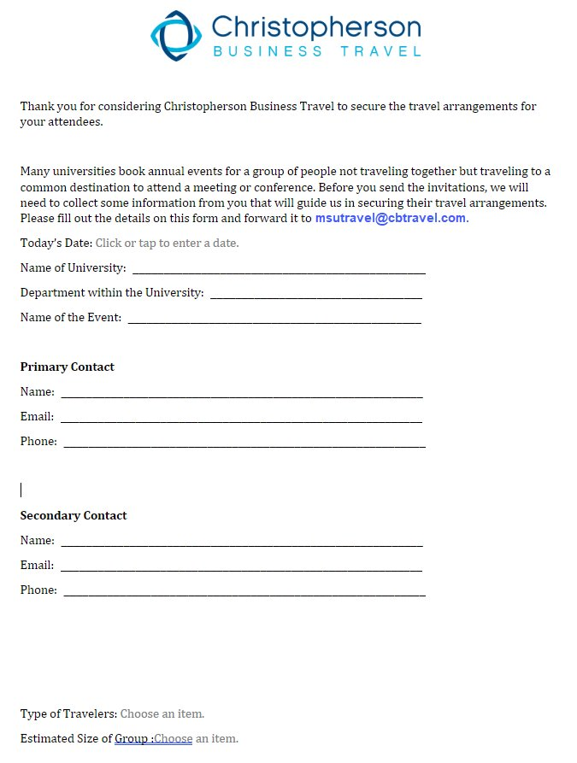
Event Travel
EVENT = Usually 10 or more travelers, not traveling together, but traveling to a common destination to attend a meeting, conference or occasion.
Complete the Event intake form MSU Event Intake Form and email to msutravel@cbtravel.com
An advisor will respond with instructions to provide the attendees prior to them booking.
Attendees book their own travel by contacting an advisor via phone or email and they follow the instructions on how to identify themselves with the specific event.
msutravel@cbtravel.com | 800-509-7081

Slide 14
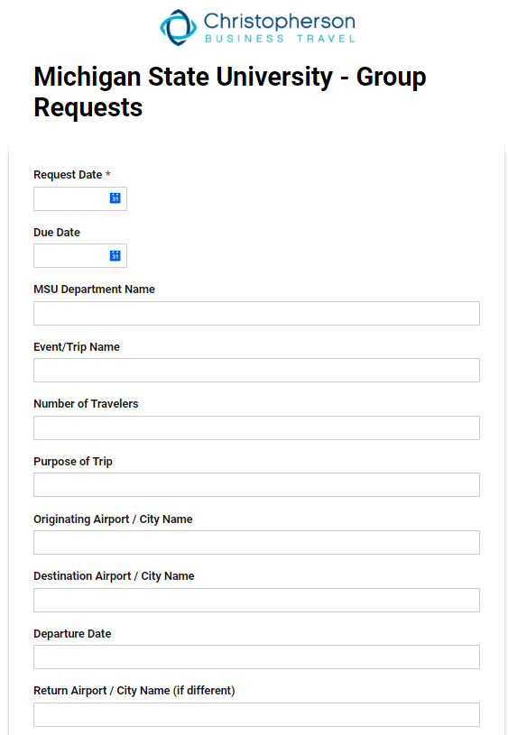
Group Travel
GROUP = 10 or more travelers on the same flights, to and from the same destinations for the same event or occasion.
Complete the University Group form MSU Group Travel Request Form
Often there is a single group coordinator who collaborates with the advisor
Individuals do not manage their own arrangements
Group bookings would use the same form of payment
msugrouptravel@cbtravel.com | 866-371-3580

Slide 15
Budget Requests | Group Block Pricing
Process used when exploring flight options, but not yet ready to commit to a group block.
Example: You are looking at various travel dates, number of people and/or destinations.
An advisor will pull up current inventory and provide ticket prices for individual tickets as a guideline.
Group fares are typically higher in cost than individual flights and inventory and pricing will always be subject to change until ticketed.
Consider this a ballpark estimate to get you started on your budget.
When ready to book, an airline group contract can be secured.
To request a quote, email msugrouptravel@cbtravel.com.
msugrouptravel@cbtravel.com | 866-371-3580

Slide 16
MSU Designated Group Advisor Team​
Advisor Name​ | Experience ​
Dawn Reeves | 4 years of group booking experience 1 year with Christopherson​ Dawn is passionate about customer service Very detail oriented​ Well versed all aspects of higher education ​
Anna Braatz | 20 years in the industry​ Newer to Christopherson​ Anna’s favorite part of booking group travel is working on the unique needs of each group​ She also thrives on incredible customer experience
All advisors are experienced in Fly America regulations
msugrouptravel@cbtravel.com | 866-371-3580

Slide 17
​
Q & A
msutravel@cbtravel.com | 800-509-7081

Slide 18
Thank you for your partnership!

